Slide 1


AI-assisted Internship and Job Matchmaker
Presented By:
Ashish Namdeo, Mohith Kanthamneni, Kaung Khant
1

Slide 2

Agenda
Introduction
Methodology
Challenges
Dataset
System Architecture
Result and Evaluation
Live Demo
Future Work
2

Slide 3
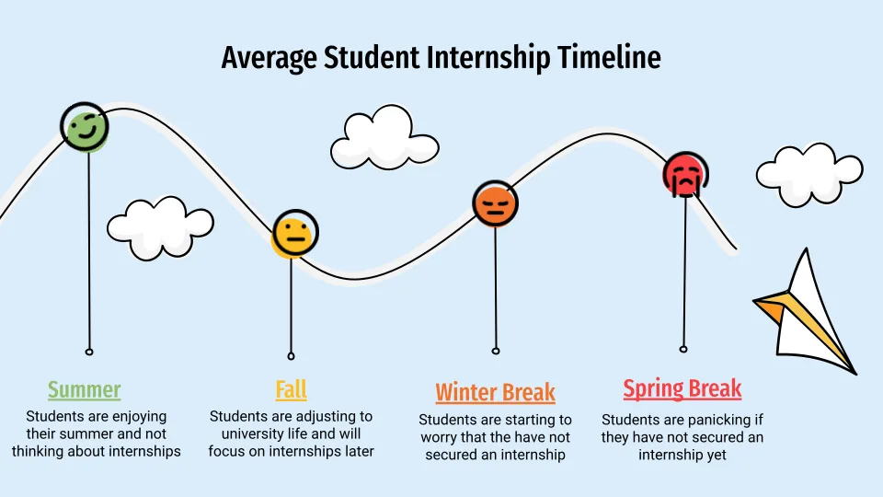
Introduction
Manual job and internship searching is tiring, time-consuming, and often leads to the wrong roles.
InternSloth simplifies these processes by matching relevant skills on a Resume to the most pertinent real-time internship or job positions
3

Slide 4
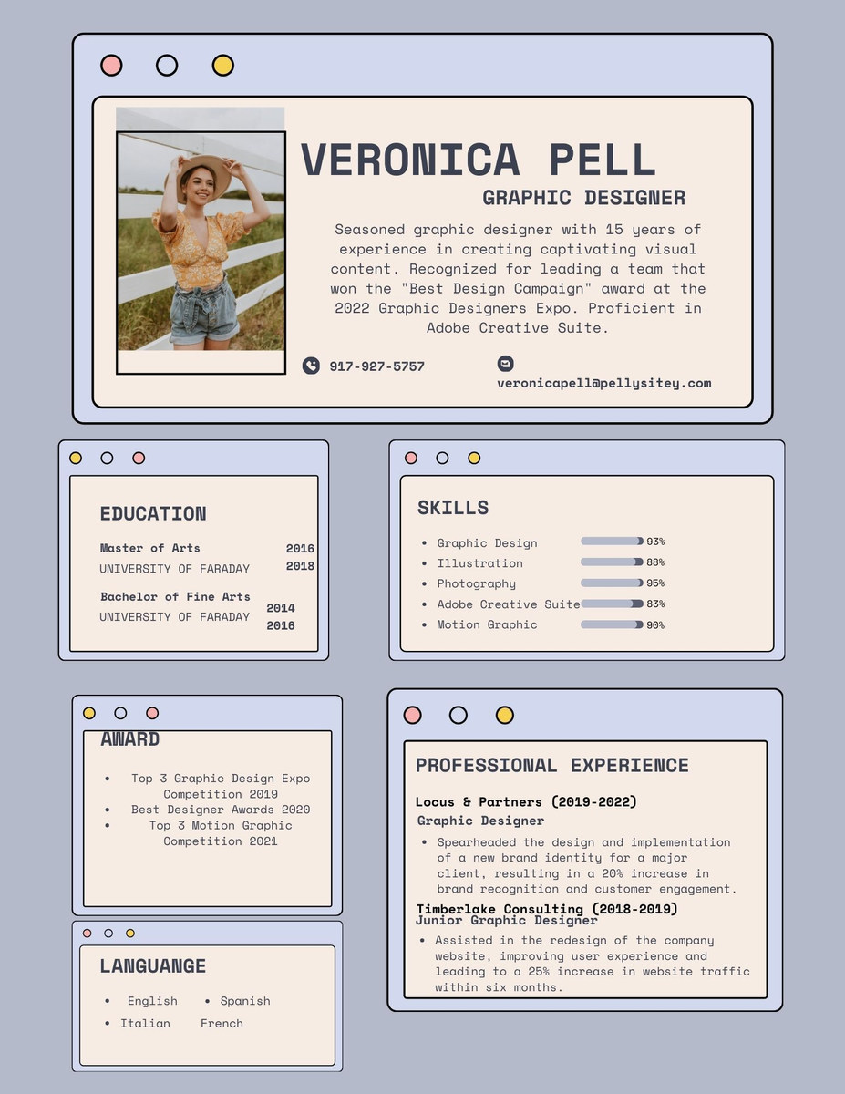
Major Challenges
Messy Resume Text: Resumes come in many formats and styles, making it hard to clean and prepare the text for analysis.
Training BERT is Tricky: Fine-tuning BERT needs powerful GPUs, and it’s easy to make mistakes that can slow down or crash your system.
Similar Words Confuse the Model: Without cleaning and standardizing similar words, BERT may treat them as completely different, which can hurt accuracy.
4

Slide 5
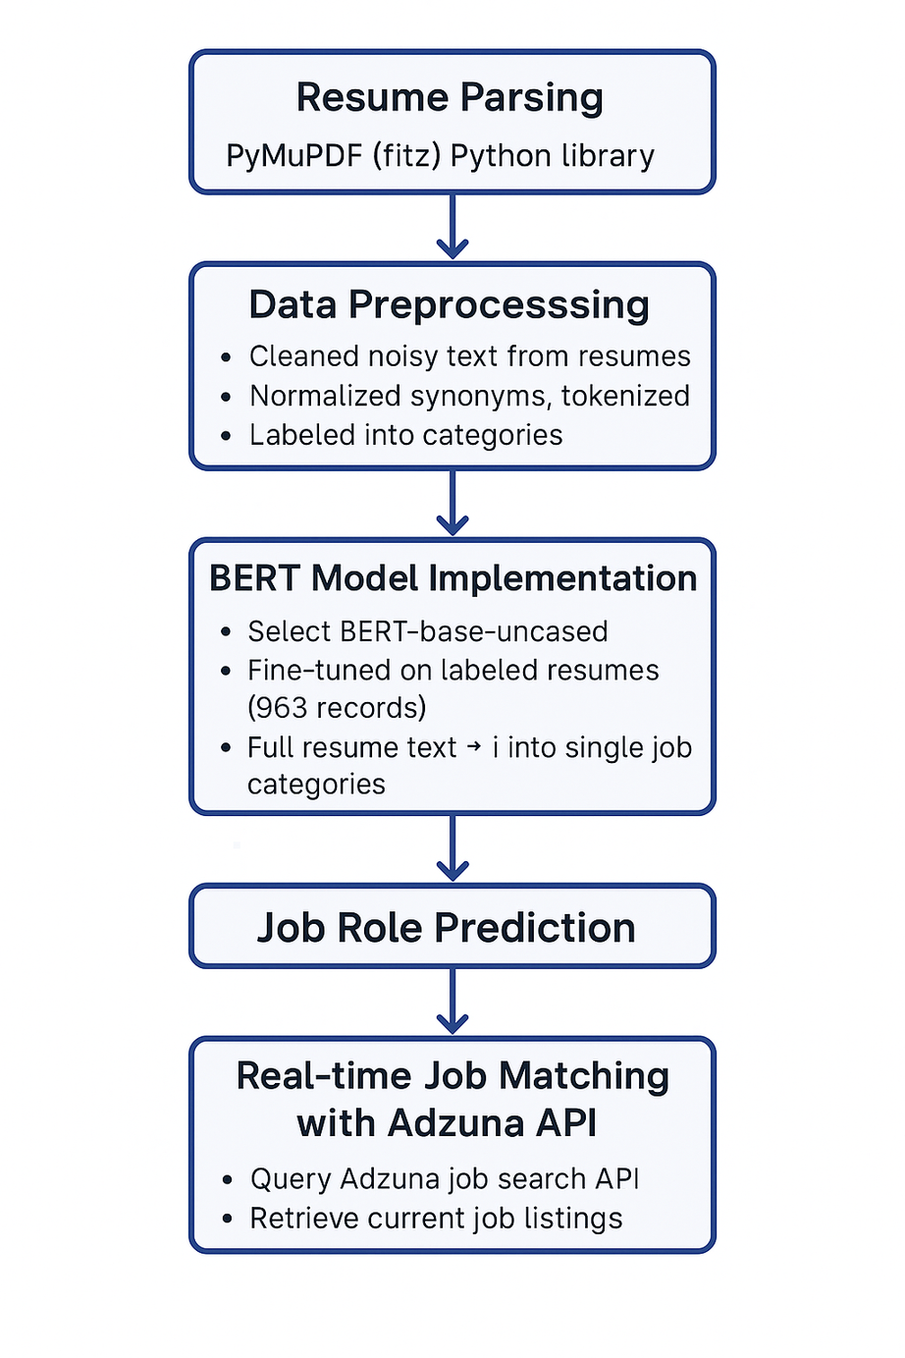
Methodology
5

Slide 6
Dataset
Dataset Source: Hugging Face
Number of Dataset records: 962 samples
Number of Features: 2 (column 1 -Category, column 2 - Resume)
Training : 80%, Testing : 20%
6

Slide 7
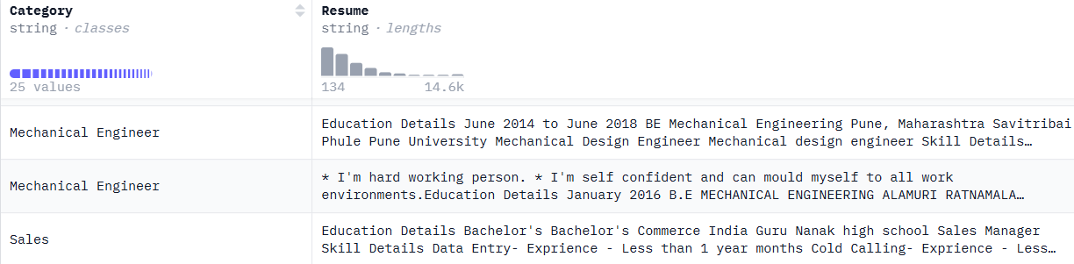
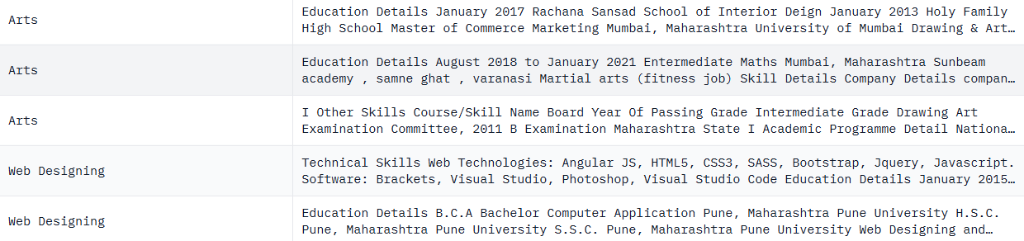
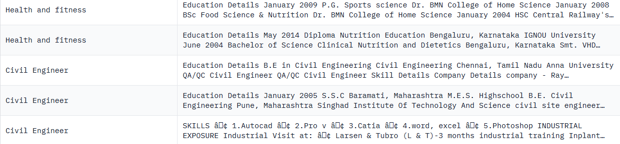
Dataset - Intern Categories and Resume
7

Slide 8
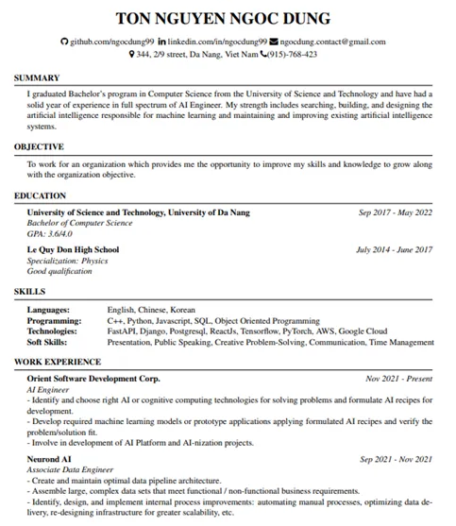
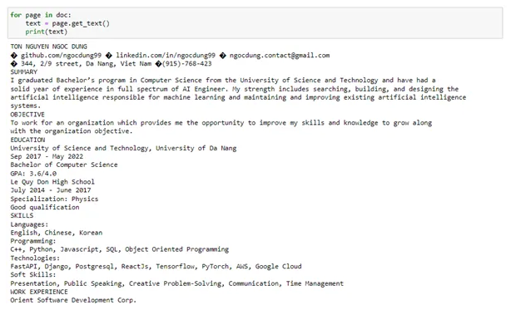
Resume Parsing using PyMuPDF Python Library
PyMuPDF (imported as fitz) is a text extraction library in Python used for working with PDF files.
8

Slide 9
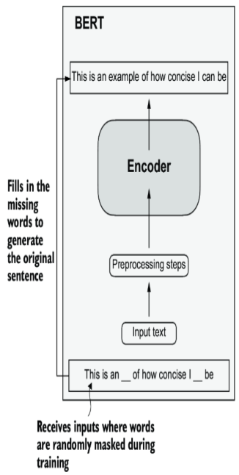
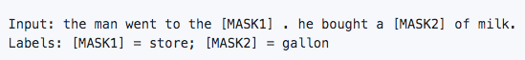
Natural Language Processing Model - BERT
BERT (Bidirectional Encoder Representations from Transformers)
Two stages of BERT: Pre-training and Fine-tuning
Pre-trained mode - A large model (24-layer Transformer, 340 M parameters) on a large corpus (Wikipedia + BookCorpus) for a long time (1M update steps), used BERT-base-uncased
Fine-tuning - During training,
Feed in the resume_content text and its correct job_role.
BERT fine-tunes its weights and learns to associate certain kinds of resumes with specific job roles.
9

Slide 10
How BERT is used in Internsloth?
Reads the resume bidirectionally left <-> right, meaning it understands the relationship between skills, experience, and roles no matter where they appear in text.
Understand the full context of the resume — not just predict next words unlike GPT transformers.
Captures context and synonyms, aligning resume phrases with job-post wording far better than TF-IDF (or) Word2Vec (e.g. JS <-> Java Script, ML <-> Machine Learning)
Single label classification, Input: one full resume (as plain text). Output: one label (e.g., "Backend Developer", "Data Scientist", etc.).
10

Slide 11

Job Search API (Adzuna)
A tool that allows apps (or) websites to search for job listings from all over the internet.
Use the Predicted role from the BERT NLP model to search the relevant job results using Adzuna API.
API End Point -
https://api.adzuna.com/v1/api/jobs/us/search/5?app_id=${application_id}&app_key=${key_value}&results_per_page=10&title_only=${predicted_role}
11

Slide 12
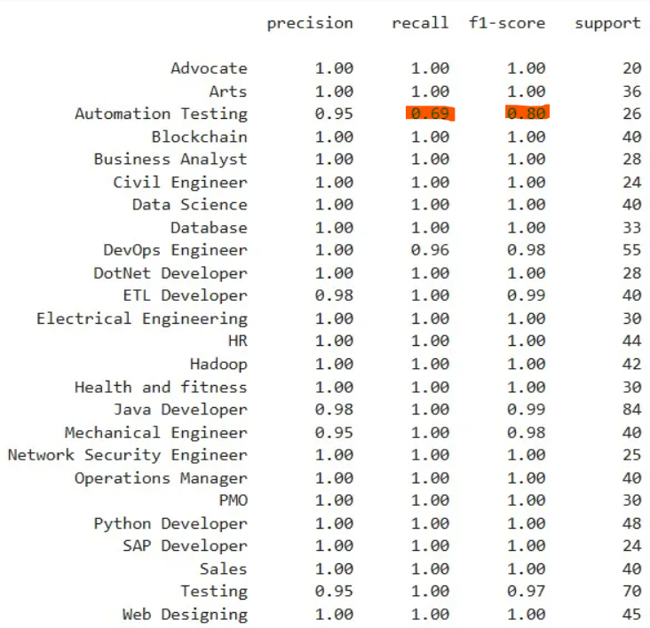
Results
Small classes (Advocate = 20) hit 1.0/1.00/1.00 for precision, recall and f-1 score
Reality check: one extra mistake would drop F1 to 0.95 so the perfect scores still mean vulnerable; more data would stabilize them
Largest class (Java Developer = 84) still holds 0.99 F1 score which means credible and reliable for large examples
12

Slide 13
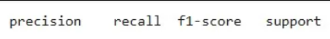
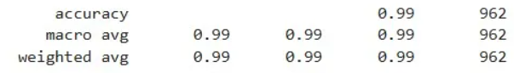
Evaluation
Metric | Score & Plain Meaning
Accuracy | 0.99 — the model gets the right job label on 99 out of 100 résumés.
Macro-average F1 | 0.99 — even the small, hard-to-find job categories score about 99 %; the model doesn’t ignore rare roles.
Weighted-average F1 | 0.99 — when we give big categories more weight (to mirror real data), performance is still 99 %, so common roles are covered just as well.
13

Slide 14
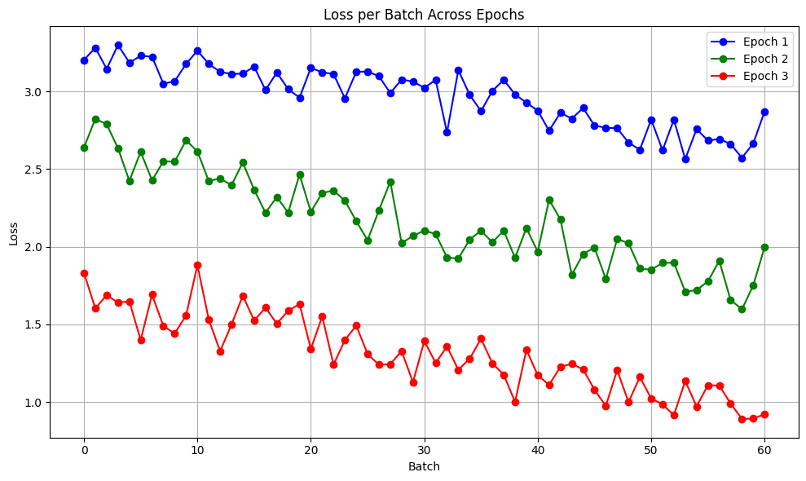
Evaluation
Loss and Accuracy
Loss - running error score (0 means perfect, higher = more error in accuracy)
Sharp fluctuations (loss-spikes) - get smaller each epoch, showing the model is learning tricky resume patterns—not just the easy ones
Curve is flattening out, meaning extra epochs would give tiny gains but risk over-fitting
Three epochs at high accuracy with efficient training - good stopping point
14

Slide 15
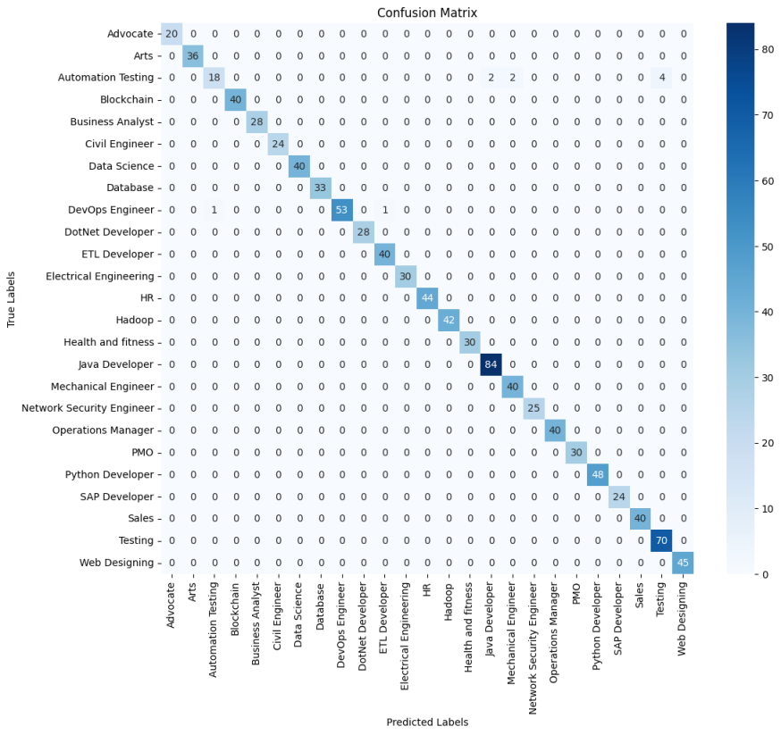
Confusion Matrix
Automation Testing’s keywords similar to Java Developer and Testing which are large classes in Dataset
Model picks the more common label when signals collide
How to Solve?
Automatic Testing - to target with extra data or multi-label training
15

Slide 16

Live Demo
16

Slide 17
Future Work
Automatic Application Submissions: Without manually applying, the system will apply all the real-time job positions on platforms (Potential AI ethics considerations and Data Privacy concerns)
Refining as Intelligent Career Assistance System
Reinforcement Learning for adaptation to learning advanced features
Web-Scrapping - gather live internship or job postings and feed them into your matching model
Integration of Personalized Resume Analysis with Skill Gap Radar and AI Interview-Coach with current system
17

Slide 18
Thank you
Q&A
18

